Slide 1

Questions
Group 670

Slide 2

CONTENT
GENERAL GUIDELINES
STUDENTS
PBL
RESEARCH AND RANKING
BUSINESS COLLABORATION
STRATEGY 2016-21

Slide 3
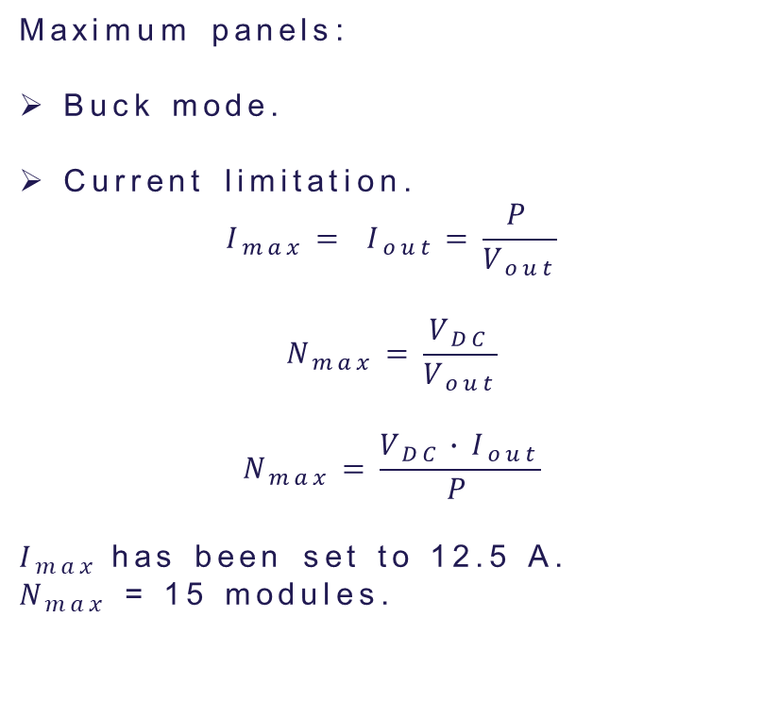
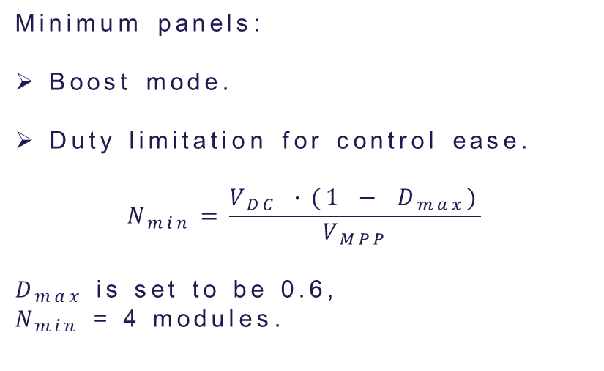
Minimum and maximum number of panels
Maximum panels:
Buck mode.
Current limitation.
$$I_{max}= I_{out}=\frac{P}{V_{out}}$$
$$N_{max}=\frac{V_{DC}}{V_{out}}$$
$$N_{max}=\frac{V_{DC}∙I_{out}}{P}$$
$I_{max}$has been set to 12.5 A.
$N_{max}$ = 15 modules.
Minimum panels:
Boost mode.
Duty limitation for control ease.
$$N_{min}=\frac{V_{DC} ∙(1 − D_{max})}{V_{MPP}}$$
$D_{max}$ is set to be 0.6,
$N_{min}$ = 4 modules.

Slide 4
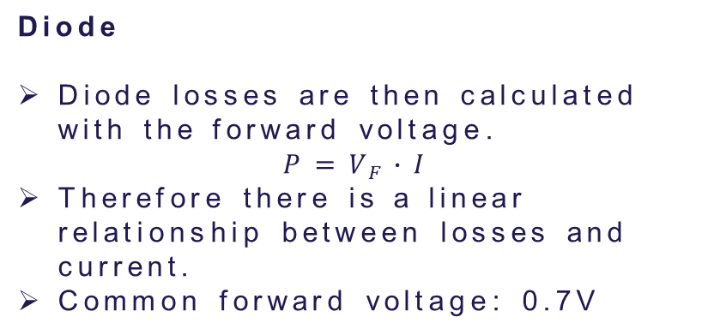
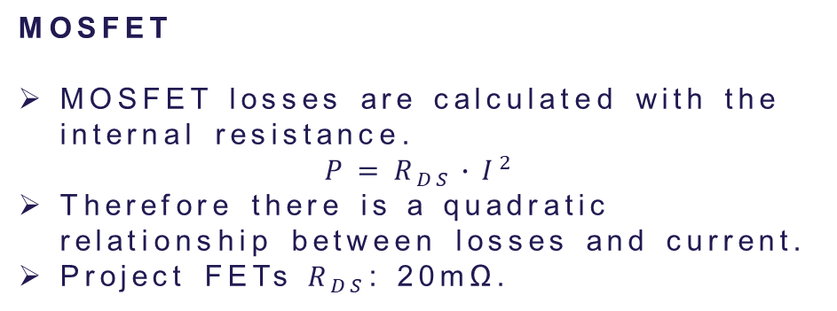
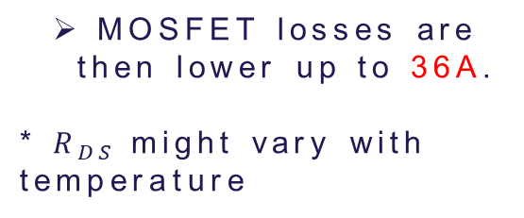
Why are there more losses in diodes than MOSFETs
Diode
Diode losses are then calculated with the forward voltage.
$$P=V_{F}∙I$$
Therefore there is a linear relationship between losses and current.
Common forward voltage: 0.7V
MOSFET
MOSFET losses are calculated with the internal resistance.
$$P=R_{DS}∙I^{2}$$
Therefore there is a quadratic relationship between losses and current.
Project FETs $R_{DS}$: 20mΩ.
MOSFET losses are then lower up to 36A.
* $R_{DS}$might vary with temperature

Slide 5
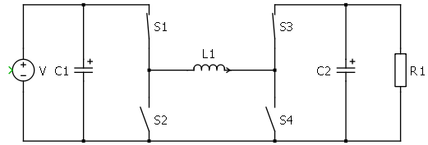
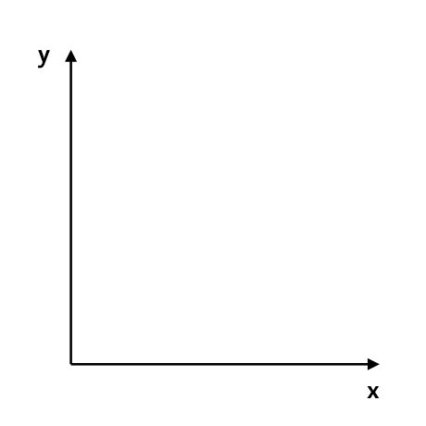


DCM
MOSFETs do not prevent reverse current like a diode would.
DCM mode is never reached when working with the 4 transistors.
Instead current would be negative through the couil.
$$I_{L}$$
$$t$$

Slide 6
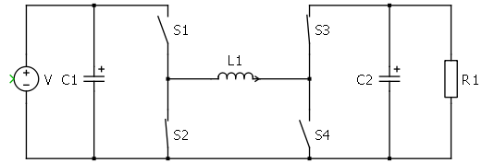
DCM
MOSFETs do not prevent reverse current like a diode would.
DCM mode is never reached when working with the 4 transistors.
Instead current would be negative through the couil.
$$I_{L}$$
$$t$$

Slide 7
DCM
MOSFETs do not prevent reverse current like a diode would.
DCM mode is never reached when working with the 4 transistors.
Instead current would be negative through the couil.
$$I_{L}$$
$$t$$

Slide 8
DCM
MOSFETs do not prevent reverse current like a diode would.
DCM mode is never reached when working with the 4 transistors.
Instead current would be negative through the couil.
$$I_{L}$$
$$t$$

Slide 9
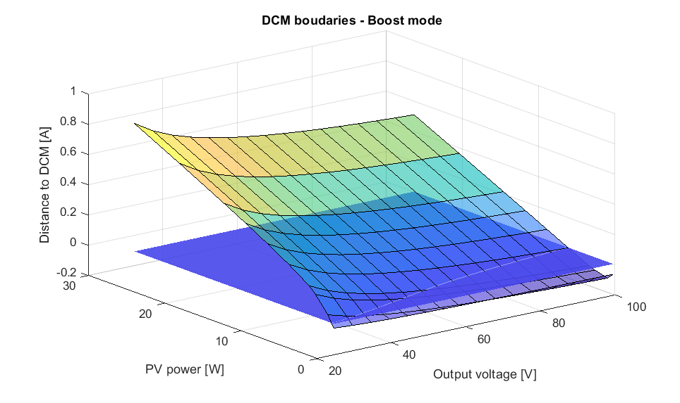
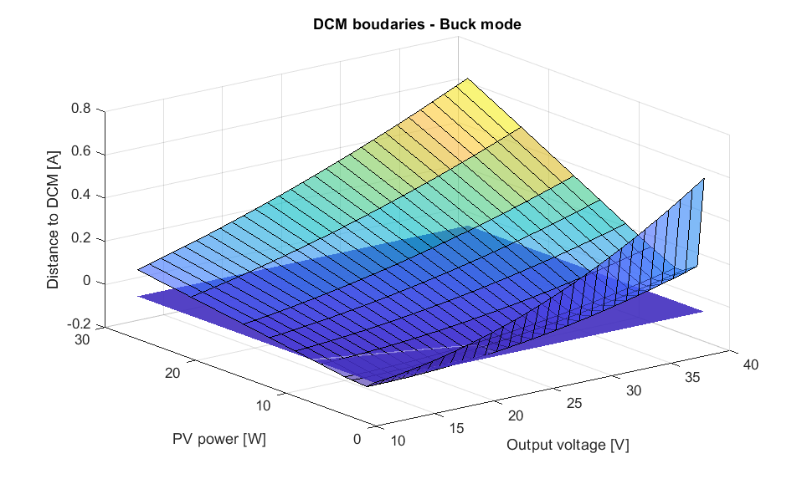
DCM
DCM mode depends on output voltage and power generated.

Slide 10
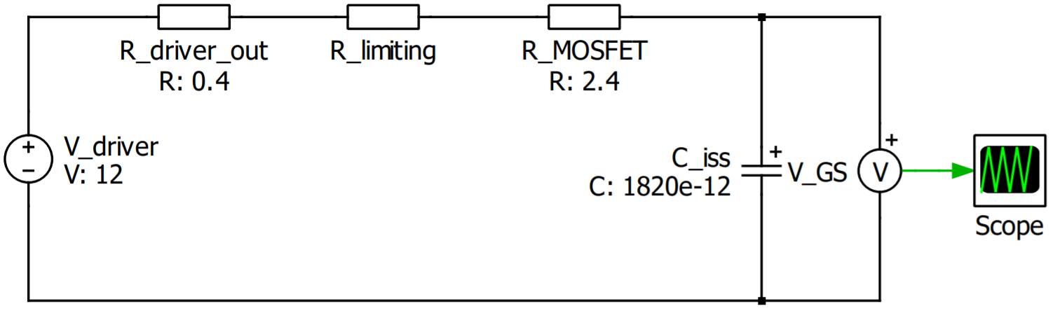

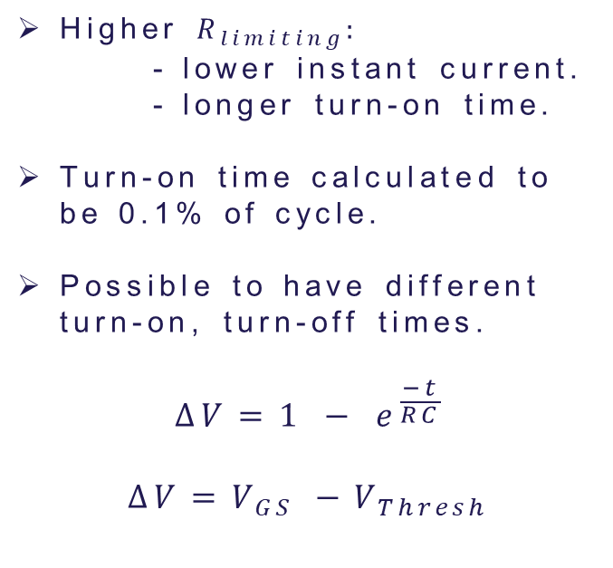
Limiting resistance
OUT H
$$R_{limiting}$$
Higher $R_{limiting}:$
- lower instant current.
- longer turn-on time.
Turn-on time calculated to be 0.1% of cycle.
Possible to have different turn-on, turn-off times.
$$∆V=1 − e^{\frac{−t}{RC}}$$
$$∆V=V_{GS} −V_{Thresh}$$
PWM
DRV
OUT L

Slide 11
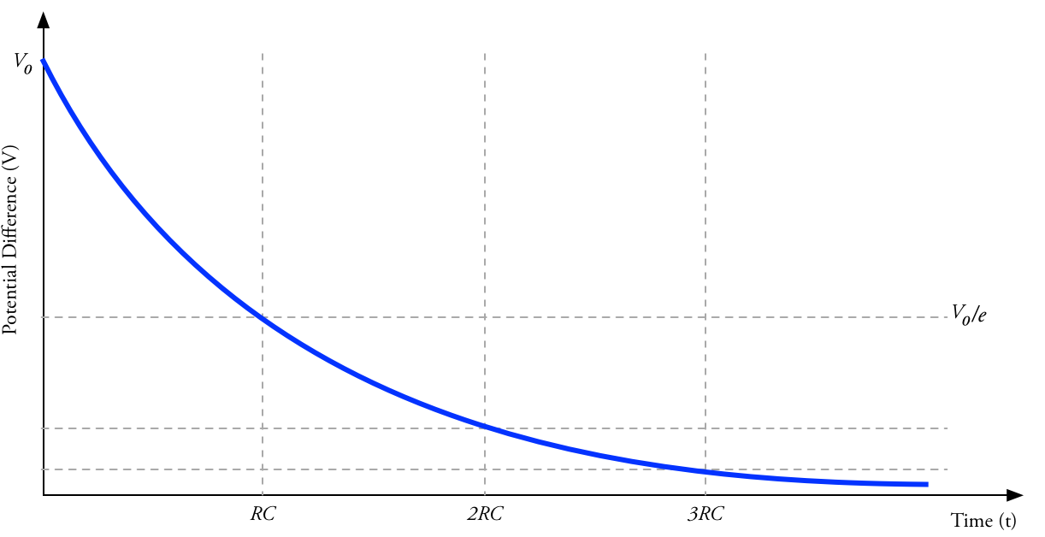
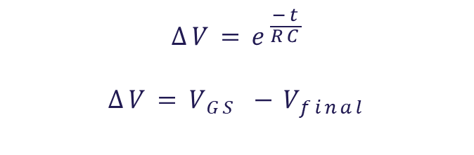



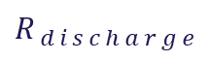
Discharging resistor
$$∆V=e^{\frac{−t}{RC}}$$
$$∆V=V_{GS} −V_{final}$$
$$R_{discharge}$$
$$C_{iss}$$
$$C_{in}$$
$$R_{discharge}$$

Slide 12
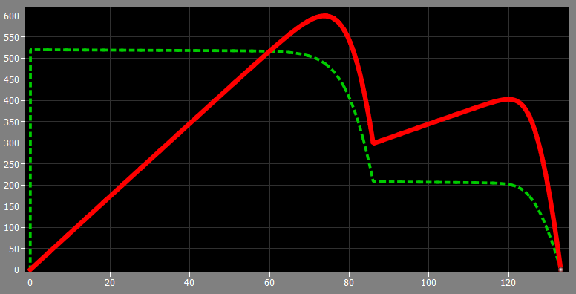
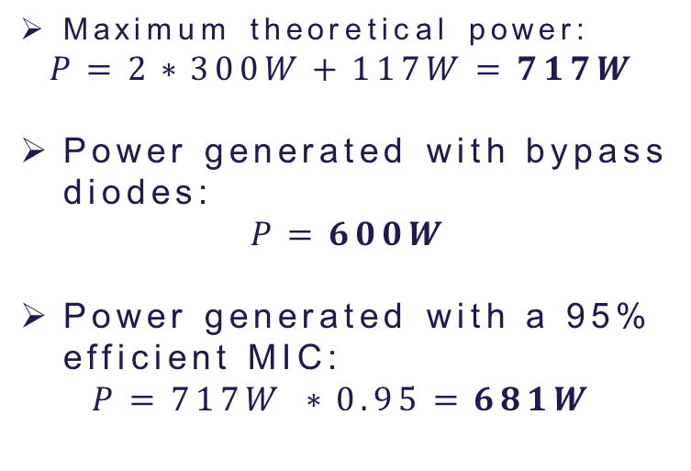
MIC advantage over bypass diode
Maximum theoretical power:
$$P=2∗300W+117W=717W$$
Power generated with bypass diodes:
$$P=600W$$
Power generated with a 95% efficient MIC:
$$P=717W ∗0.95=681W$$
Power generated in a 3 panel array with bypass diodes.
2 panels 1000 W/m2
1 panel 400 W/m2 (shaded)
25ºC

